Slide 1

Brief history of Russian (Soviet) computers
In Soviet Russia, Internet has a human addiction

Slide 2
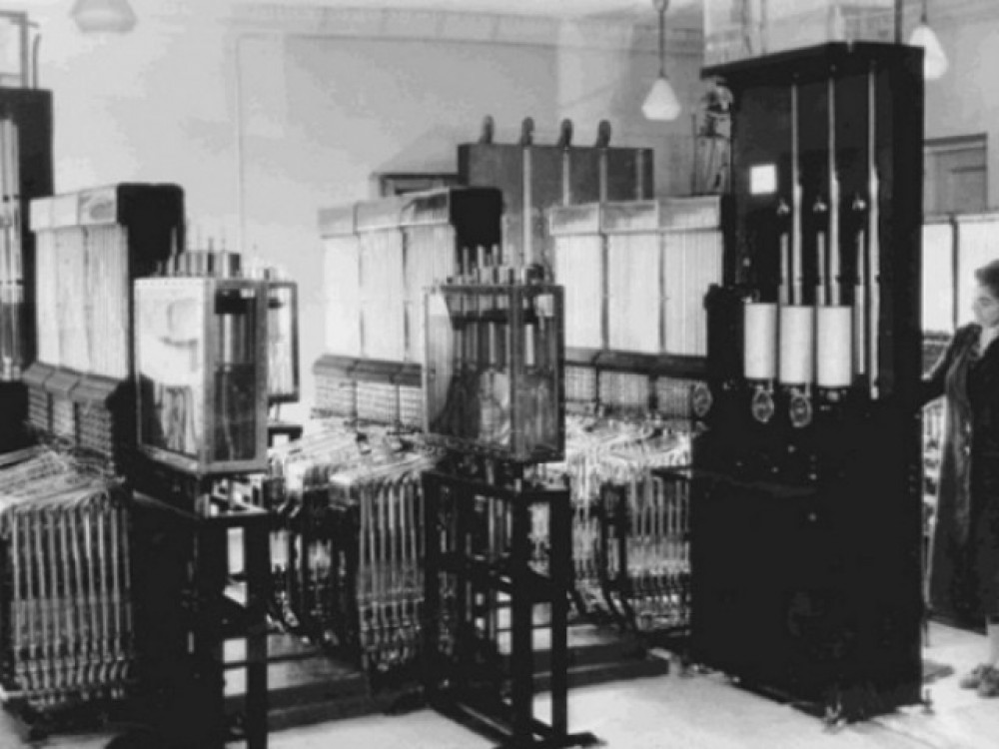
Early Soviet Union comrades
The first analog computer was made in 1936
It was the first computer in the world used to solve partial differential equations
Water level in different chambers resembled stored numbers
Water flow between them represented mathematical operations
In 40-s it was improved for solving various problems
Water Integrator

Slide 3
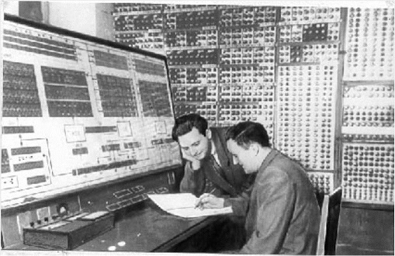
Post World War II
Digital computers development had begun after WWII
The first universally programmable computer was created
Small Electronic Calculating Machine
Could perform ~3000 operations per minute
Occupied 60 m^2
~50 Flops
MESM

Slide 4
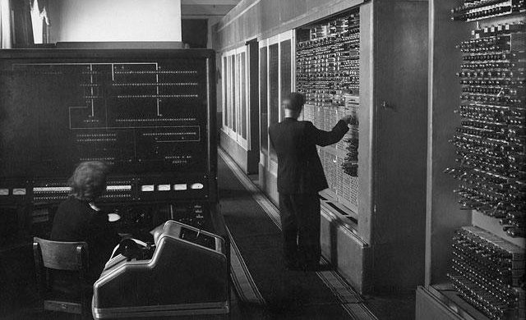
Post World War II
The first large-scale computer was built – BESM-1, only one was ever built though in 1952
It was the fastest computer in Europe: 8-10 kFlops
Could represent numbers in the range of 10^-9 to 10^10
RAM – 1024 words on ferrite cores (~5kb)
External storage ~16kb
BESM-1

Slide 5
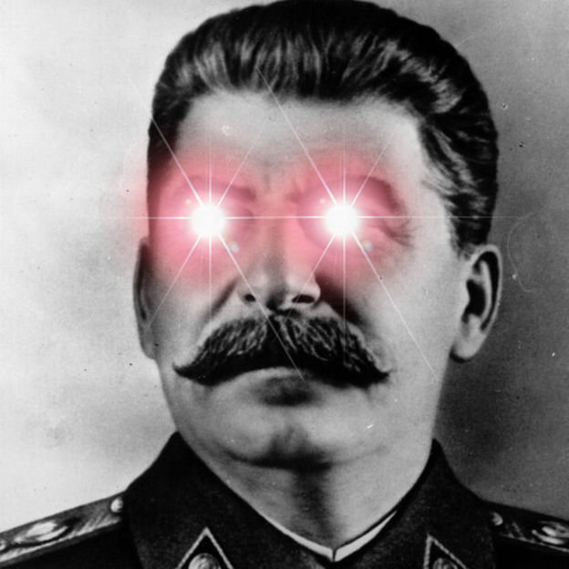
Soviet officials attitude to computer science
Comrade Stalin considered the computer to be an evil product of capitalism (and he is right tbh)
Soviet officials were skeptical or even hostile
Cybernetics is a capitalist attempt to undermine workers’ rights

Slide 6
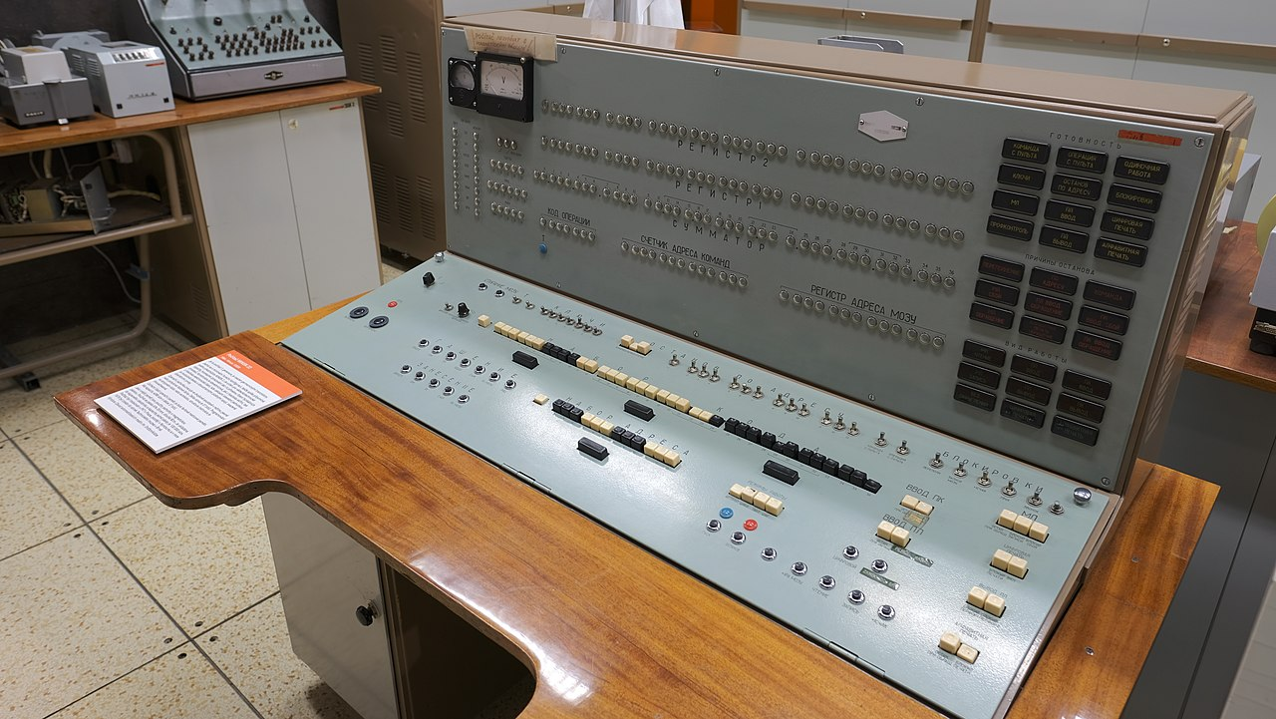
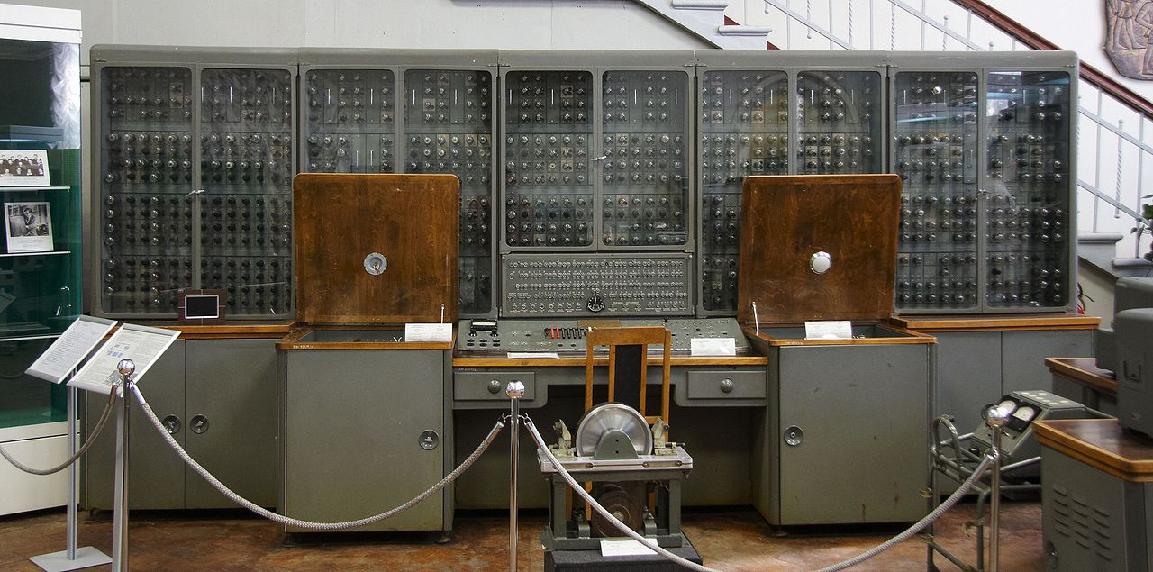
Post-Stalin era
Minsk
~70% of computers were of this type at that time
Ural
~10 kFlops

Slide 7
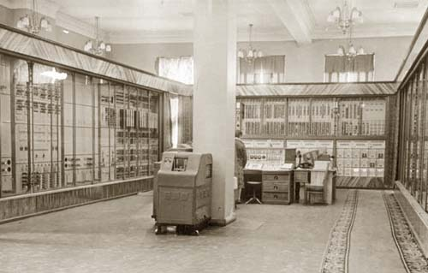
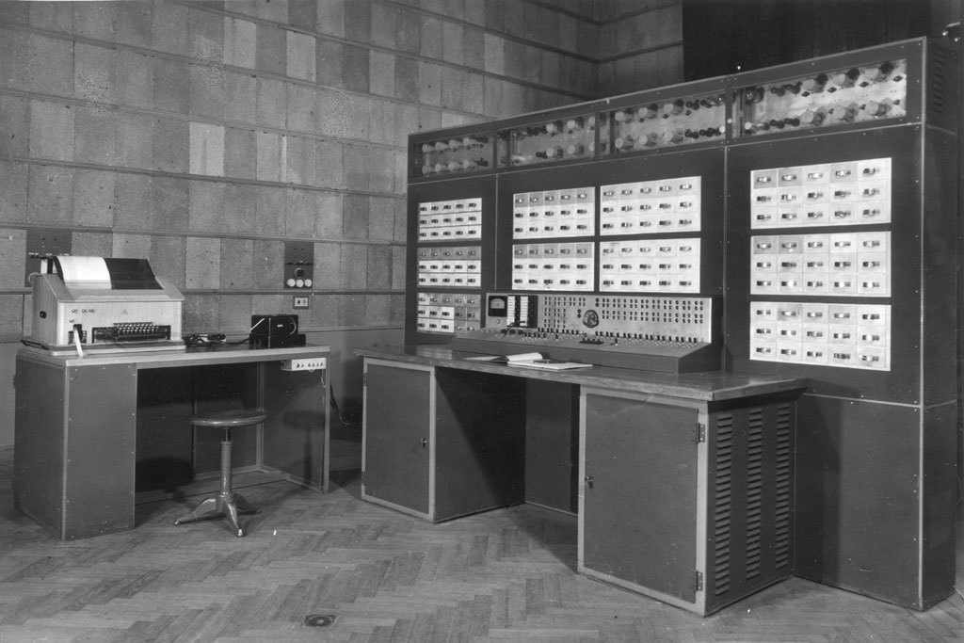
Post-Stalin Era
Strela Computer was made in 1953
Used to calculate Gagarin’s flight, Sputnik’s launch and Tu-104 aerodynamics
Was the most powerful machine for a couple of years
Setun Computer was made in 1959
It used not binary but ternary logic
Only 46 were built

Slide 8
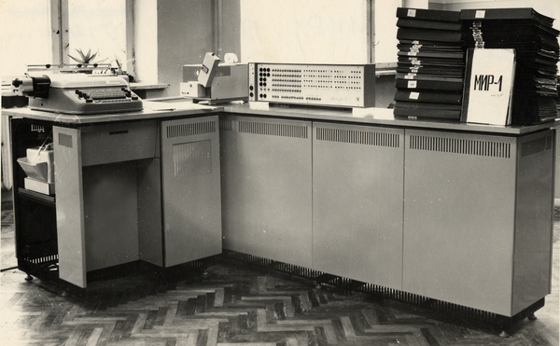
Khrushchev Thaw
Was developed in 1960-s
Stands for Machine for Engineering Calculations
Provided as a small-scale computer
Had it’s own programming language Almir (russkiy ALGOL)
~50 kFLops
MIR-1

Slide 9
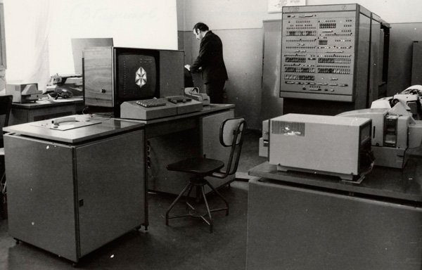
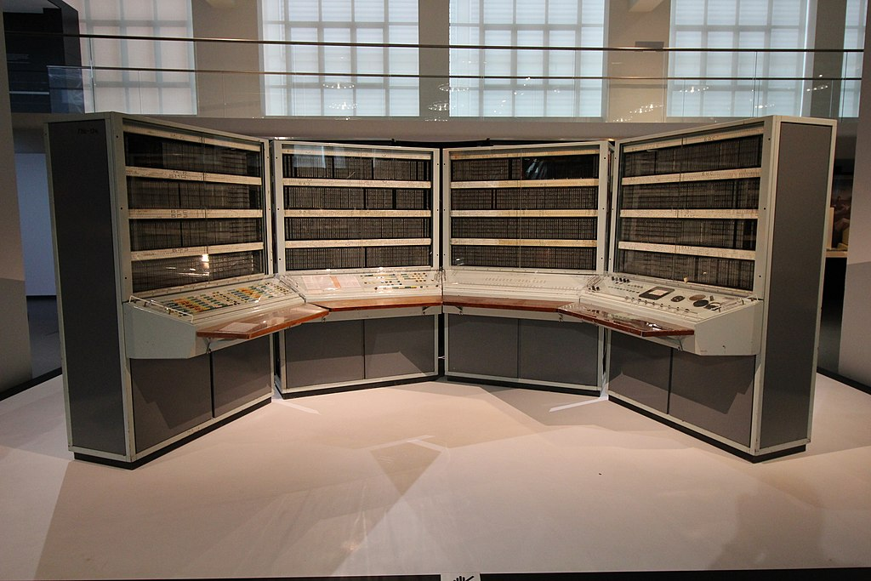
Khrushchev Thaw
Minsk 2 – the first transistor-based soviet computer
Can be called the first soviet personal computer
7 kFlops, CPU clock = 7 HHz
About 1000 units were produced
First transistor-based soviet computer of second generation– BESM 6
0,5 Mflops, CPU clock = 9MHz
RAM – 192 KB

Slide 10
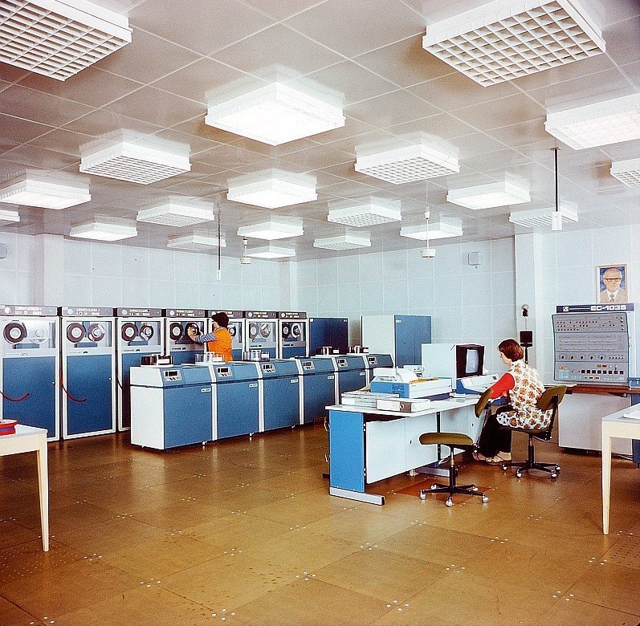
70-s
RIP Russian computer science, It’s gone forever
Importing IBMs and making their compatibles (ES EVM)
Programming languages: ALGOL, COBOL, FORTRAN
At least Elbrus supercomputers were made
ES EVM

Slide 11
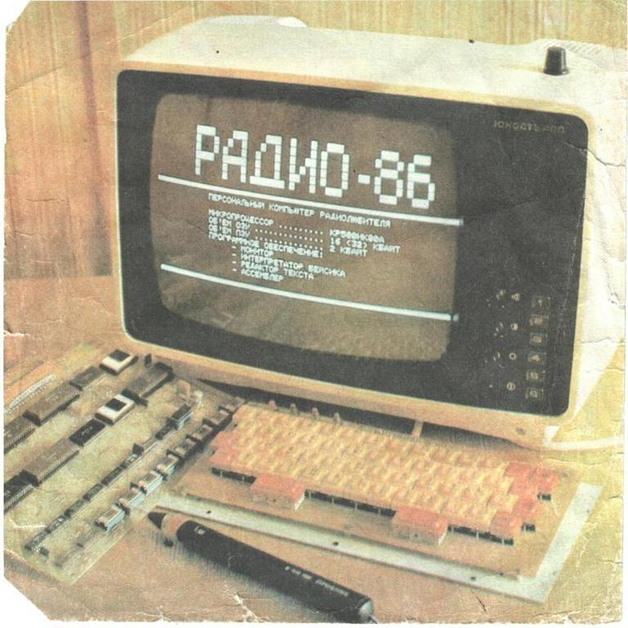
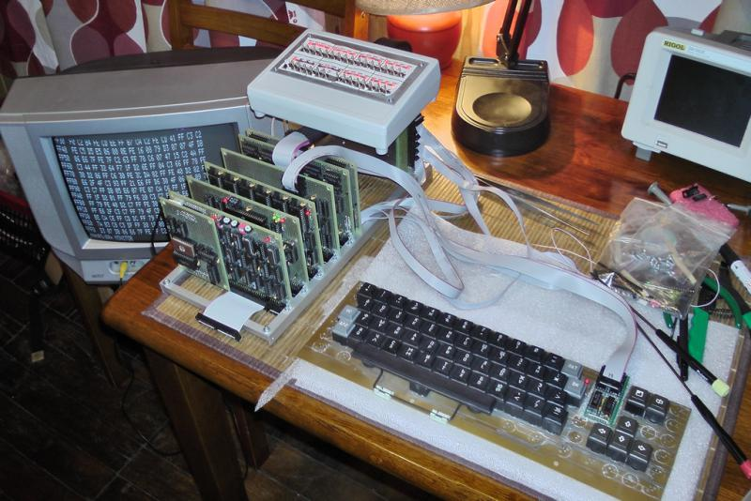
Early 80-s
Radio 86RK – a successor to Mirco-80
The struggle continues
Amount of PCs = 200’000
Amount of programmers = 300’000
Western software
Micro-80, first do-it-yourself home computer, cpu is a 8080 clone

Slide 12
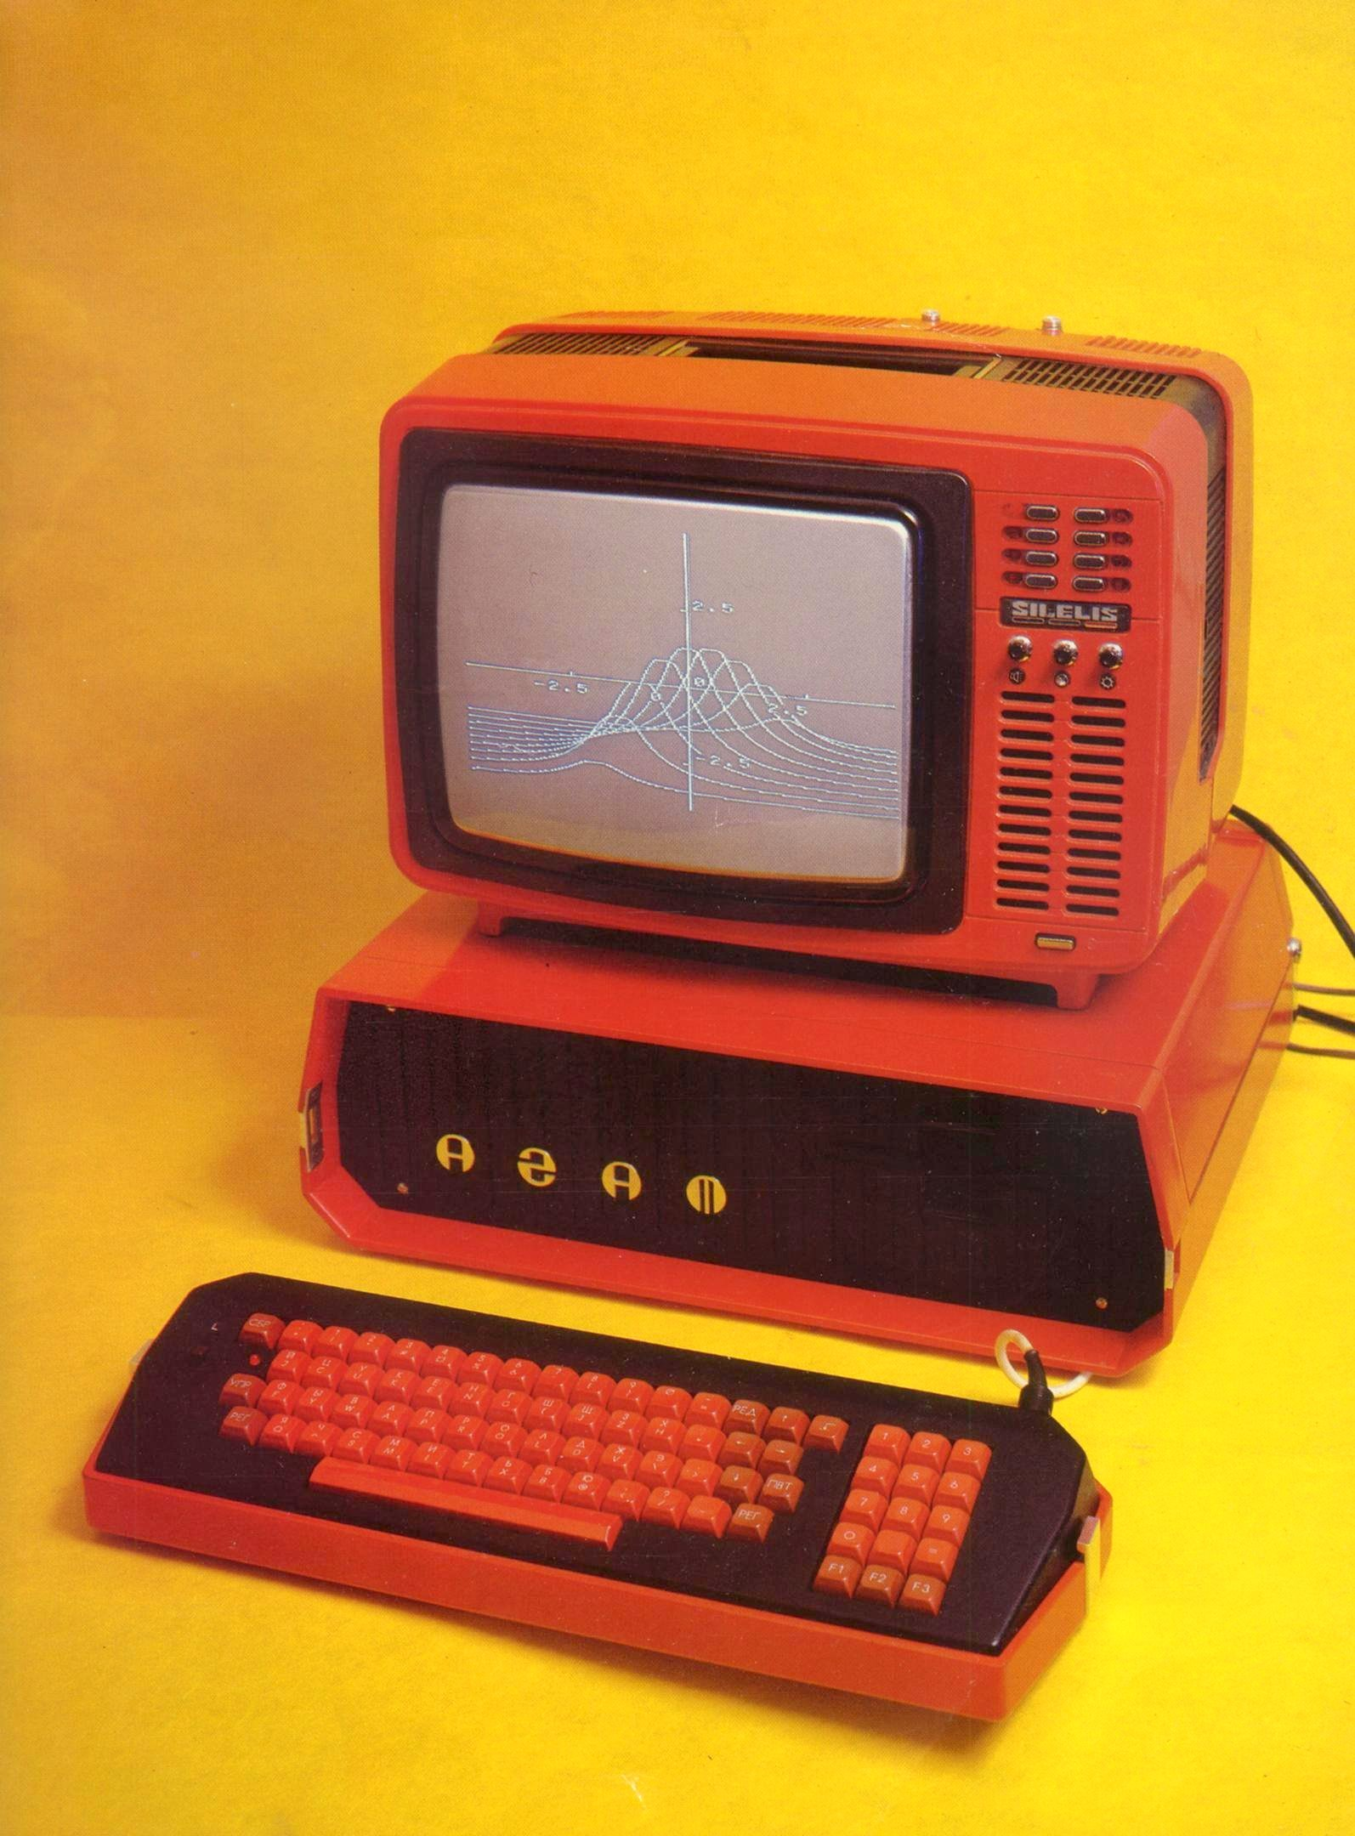
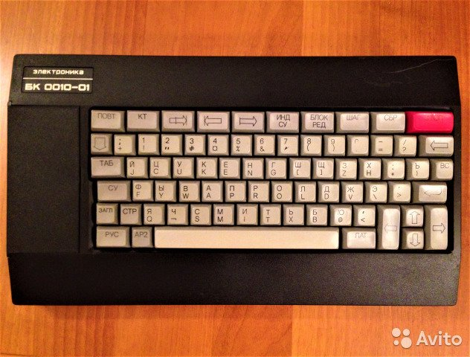
Perestroika time
Agat – Apple II Clone
All computers are basically clones of western machines
All of them have poor reliability
Electronica BK 0010-01 the only “official” PC for home usage

Slide 13
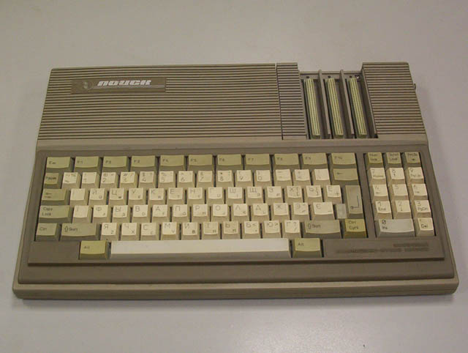
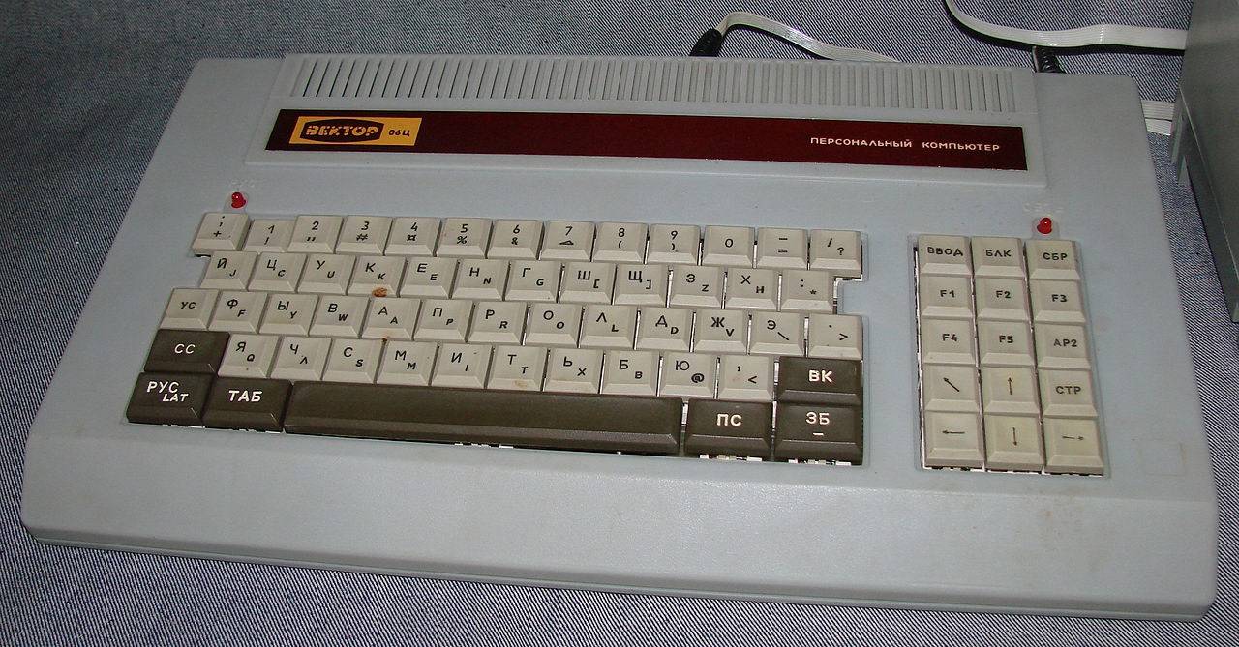
Perestroika time
Vector 06-c had great graphic possibilities
Poisk – IBM compatible

Slide 14

That’s it, comrades

